Slide 1

Design Example: Serial Data Code Converter
ECE 2372 | Modern Digital System Design | Texas Tech University

Slide 2

Lecture Overview
Design Specification
State Graph
State Table
Transition Table
Next-State and Output Equations
Verilog Implementation

Slide 3
Design Specification
Serial Data Code Converter | Modern Digital System Design

Slide 4
Design Specification
Binary data is often transmitted between computers as a serial stream of bits.
There are multiple schemes for how this serial bitstream should be formatted.
We will design a sequential circuit that can convert a bitstream from one popular form, to another.

Slide 5
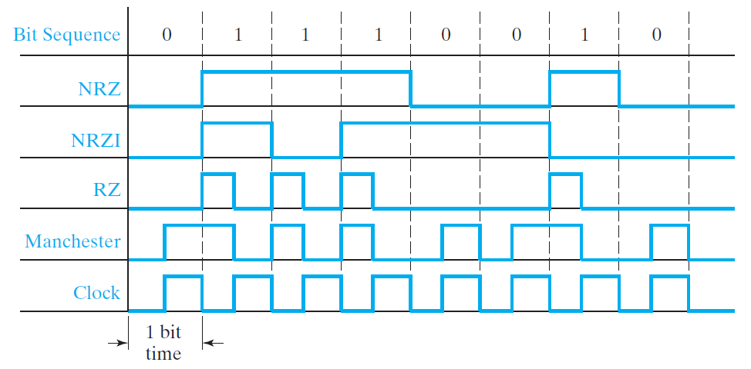
Coding Schemes for Serial Data Transmission

Slide 6
Design Specification
Our Serial Data Code Converter will have two inputs:
CLK: The system clock.
N: A serial bitstream using an NRZ Coding Scheme.
and one output:
M: The same bitstream converted to a Manchester Coding Scheme.

Slide 7
Active-Edge of the CLK
In order to implement the Manchester coding scheme, we will need a sequential circuit which triggers on the rising and falling edge of the system clock.
This won’t affect our design process, but we’ll need to remember this when we get to Verilog.

Slide 8
Design Specification
So how many states will we need?

Slide 9
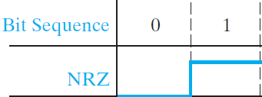
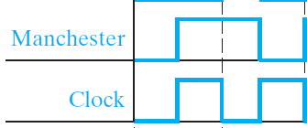
Design Specification
We will need 4 states:
At Rest (M = 0)
N = 0 (M = 0)
N = 1 (M = 1)
At Rest (M = 1)

Slide 10
Design Specifications
Design Summary
Two Inputs:
N: The NRZ bitstream
CLK: The System Clock
One Output:
M: The Manchester bitstream
Four States
Two D Flip-Flops (triggered on the rising and falling edge)
Moore Machine

Slide 11

What questions do you have?

Slide 12
State Graph
Serial Data Code Converter | Modern Digital System Design

Slide 13








$$S_{0}$$
$$S_{1}$$
$$M$$
$$M$$
$$S_{3}$$
$$S_{2}$$
$$M$$
$$M$$

Slide 14




$$S_{0}$$
$$S_{1}$$
$$0$$
$$0$$
$$S_{3}$$
$$S_{2}$$
$$1$$
$$1$$

Slide 15




$$S_{0}$$
$$S_{1}$$
$$0$$
$$0$$
$$At Rest (M=0)$$
$$Start N=0$$
$$S_{3}$$
$$S_{2}$$
$$1$$
$$1$$
$$Start N=1$$
$$At Rest (M=1)$$

Slide 16
$$S_{0}$$
$$S_{1}$$
$$0$$
$$0$$
$$S_{3}$$
$$S_{2}$$
$$1$$
$$1$$

Slide 17








$$0$$
$$S_{0}$$
$$S_{1}$$
$$0$$
$$0$$
$$1$$
$$S_{3}$$
$$S_{2}$$
$$1$$
$$1$$

Slide 18



$$0$$
$$S_{0}$$
$$S_{1}$$
$$0$$
$$0$$
$$1$$
$$0,1$$
$$S_{3}$$
$$S_{2}$$
$$1$$
$$1$$

Slide 19
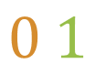

$$0$$
$$S_{0}$$
$$S_{1}$$
$$0$$
$$0$$
$$1$$
$$0,1$$
$$0,1$$
$$S_{3}$$
$$S_{2}$$
$$1$$
$$1$$

Slide 20



$$0$$
$$S_{0}$$
$$S_{1}$$
$$0$$
$$0$$
$$1$$
$$0,1$$
$$0$$
$$0,1$$
$$S_{3}$$
$$S_{2}$$
$$1$$
$$1$$
$$1$$

Slide 21


$$0$$
$$S_{0}$$
$$S_{1}$$
$$0$$
$$0$$
$$1$$
$$0,1$$
$$0$$
$$0,1$$
$$S_{3}$$
$$S_{2}$$
$$1$$
$$1$$
$$1$$

Slide 22

What questions do you have?

Slide 23
State Table
Serial Data Code Converter | Modern Digital System Design

Slide 24
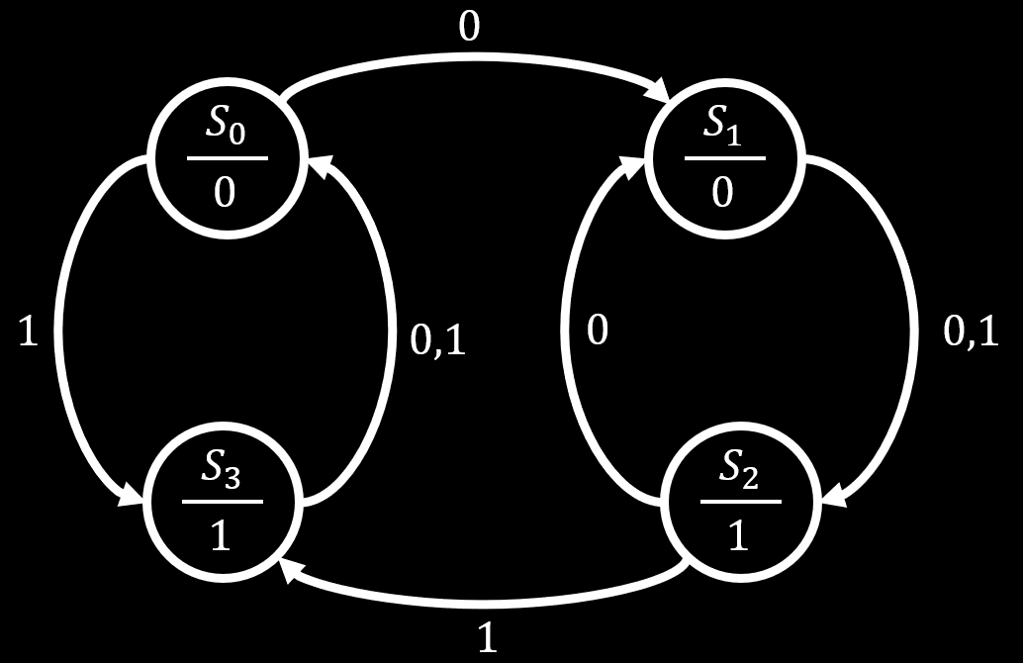
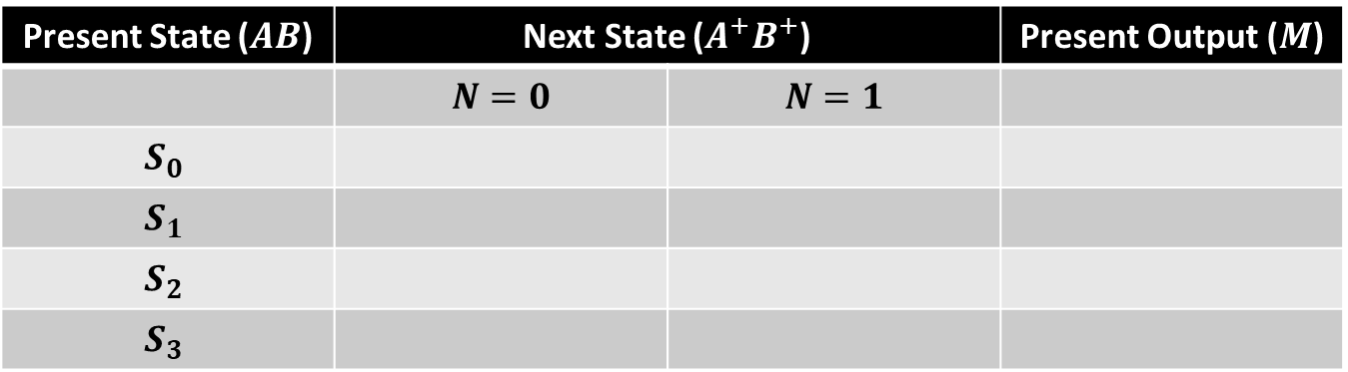
Present State ($AB$) | Next State ($A^{+}B^{+}$) |  | Present Output ($M$)
 | $$N=0$$ | $$N=1$$
$$S_{0}$$
$$S_{1}$$
$$S_{2}$$
$$S_{3}$$

Slide 25
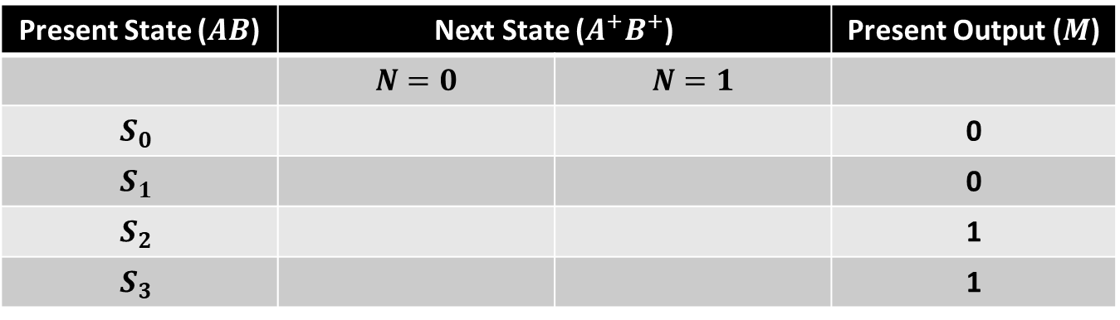
Present State ($AB$) | Next State ($A^{+}B^{+}$) |  | Present Output ($M$)
 | $$N=0$$ | $$N=1$$
$$S_{0}$$ |  |  | 0
$$S_{1}$$ |  |  | 0
$$S_{2}$$ |  |  | 1
$$S_{3}$$ |  |  | 1

Slide 26
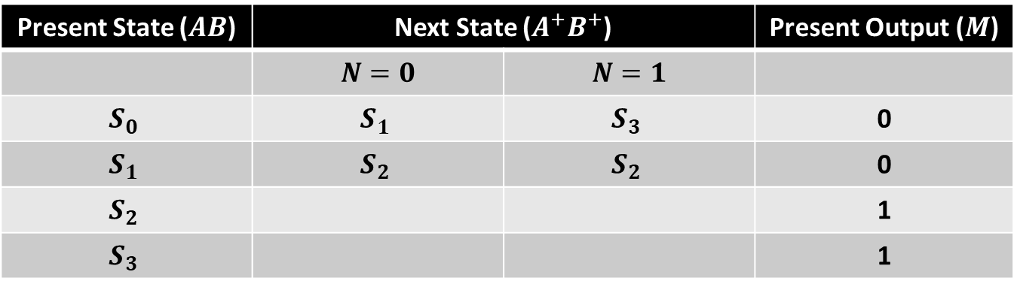
Present State ($AB$) | Next State ($A^{+}B^{+}$) |  | Present Output ($M$)
 | $$N=0$$ | $$N=1$$
$$S_{0}$$ | $$S_{1}$$ | $$S_{3}$$ | 0
$$S_{1}$$ | $$S_{2}$$ | $$S_{2}$$ | 0
$$S_{2}$$ |  |  | 1
$$S_{3}$$ |  |  | 1

Slide 27
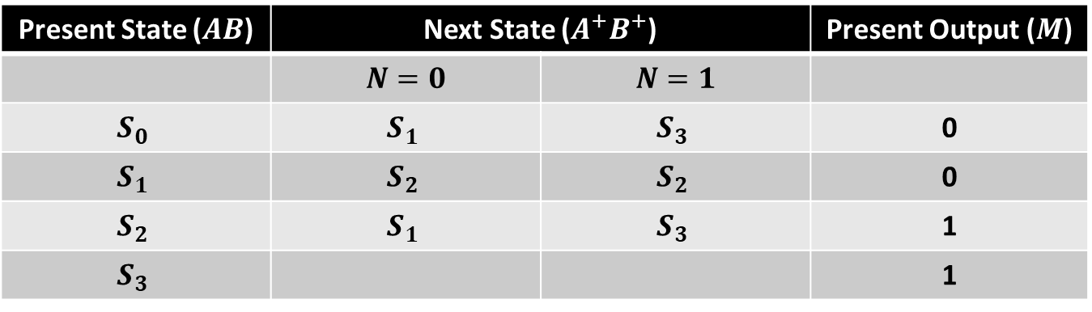
Present State ($AB$) | Next State ($A^{+}B^{+}$) |  | Present Output ($M$)
 | $$N=0$$ | $$N=1$$
$$S_{0}$$ | $$S_{1}$$ | $$S_{3}$$ | 0
$$S_{1}$$ | $$S_{2}$$ | $$S_{2}$$ | 0
$$S_{2}$$ | $$S_{1}$$ | $$S_{3}$$ | 1
$$S_{3}$$ |  |  | 1

Slide 28
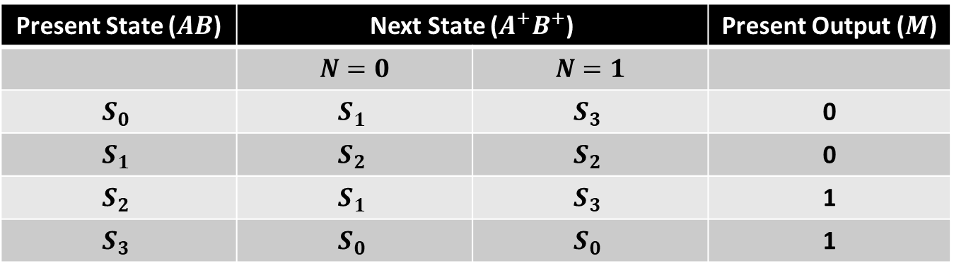
Present State ($AB$) | Next State ($A^{+}B^{+}$) |  | Present Output ($M$)
 | $$N=0$$ | $$N=1$$
$$S_{0}$$ | $$S_{1}$$ | $$S_{3}$$ | 0
$$S_{1}$$ | $$S_{2}$$ | $$S_{2}$$ | 0
$$S_{2}$$ | $$S_{1}$$ | $$S_{3}$$ | 1
$$S_{3}$$ | $$S_{0}$$ | $$S_{0}$$ | 1

Slide 29
What Questions do you have?

Slide 30
Transition Table
Serial Data Code Converter | Modern Digital System Design

Slide 31
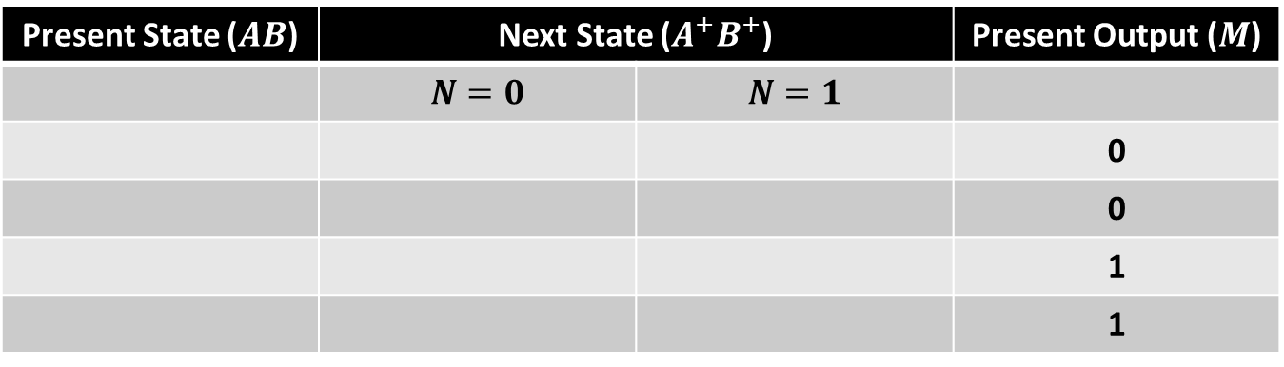
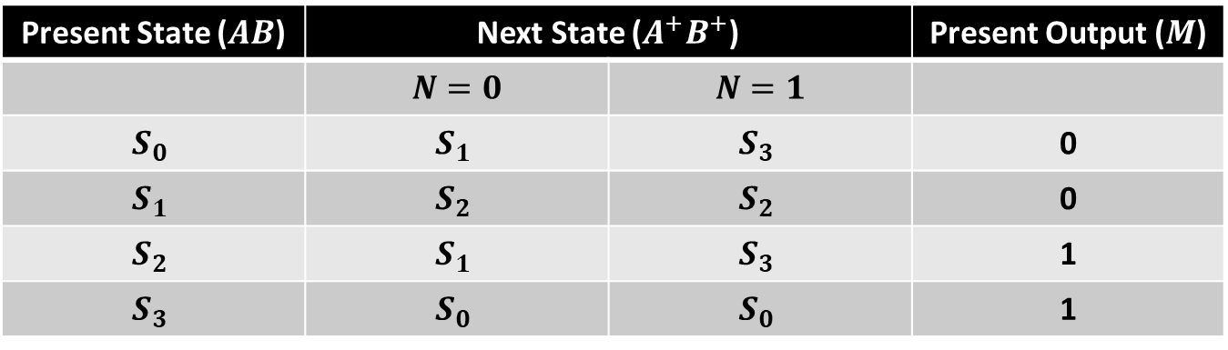
Transition Table
Present State ($AB$) | Next State ($A^{+}B^{+}$) |  | Present Output ($M$)
 | $$N=0$$ | $$N=1$$
 |  |  | 0
 |  |  | 0
 |  |  | 1
 |  |  | 1
State Table
Present State ($AB$) | Next State ($A^{+}B^{+}$) |  | Present Output ($M$)
 | $$N=0$$ | $$N=1$$
$$S_{0}$$ | $$S_{1}$$ | $$S_{3}$$ | 0
$$S_{1}$$ | $$S_{2}$$ | $$S_{2}$$ | 0
$$S_{2}$$ | $$S_{1}$$ | $$S_{3}$$ | 1
$$S_{3}$$ | $$S_{0}$$ | $$S_{0}$$ | 1

Slide 32
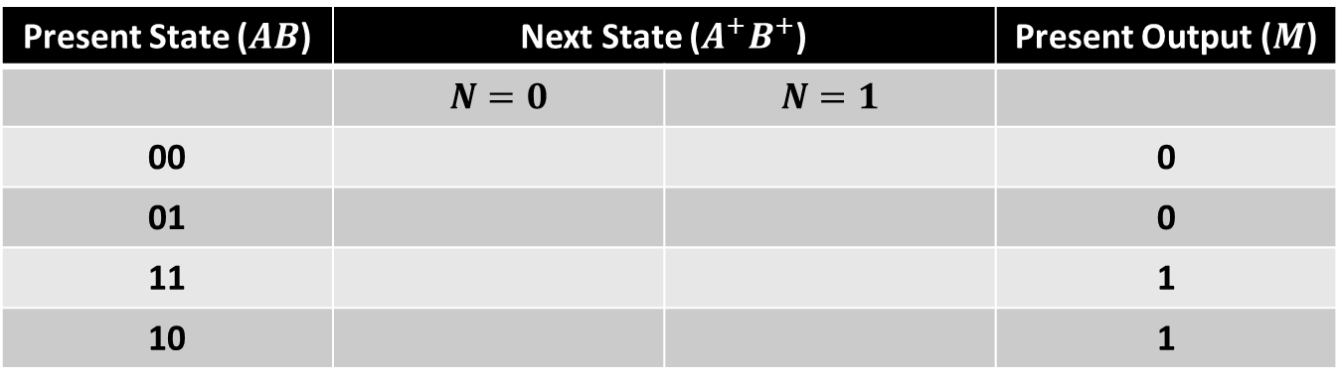
Transition Table
Present State ($AB$) | Next State ($A^{+}B^{+}$) |  | Present Output ($M$)
 | $$N=0$$ | $$N=1$$
00 |  |  | 0
01 |  |  | 0
11 |  |  | 1
10 |  |  | 1
State Table
Present State ($AB$) | Next State ($A^{+}B^{+}$) |  | Present Output ($M$)
 | $$N=0$$ | $$N=1$$
$$S_{0}$$ | $$S_{1}$$ | $$S_{3}$$ | 0
$$S_{1}$$ | $$S_{2}$$ | $$S_{2}$$ | 0
$$S_{2}$$ | $$S_{1}$$ | $$S_{3}$$ | 1
$$S_{3}$$ | $$S_{0}$$ | $$S_{0}$$ | 1

Slide 33
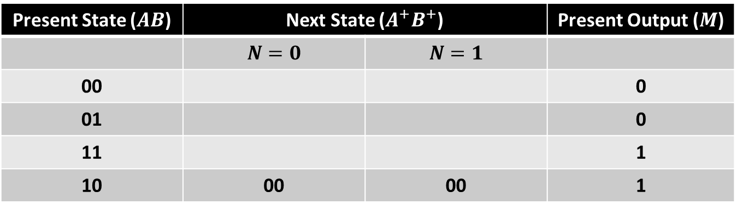
Transition Table
Present State ($AB$) | Next State ($A^{+}B^{+}$) |  | Present Output ($M$)
 | $$N=0$$ | $$N=1$$
00 |  |  | 0
01 |  |  | 0
11 |  |  | 1
10 | 00 | 00 | 1
State Table
Present State ($AB$) | Next State ($A^{+}B^{+}$) |  | Present Output ($M$)
 | $$N=0$$ | $$N=1$$
$$S_{0}$$ | $$S_{1}$$ | $$S_{3}$$ | 0
$$S_{1}$$ | $$S_{2}$$ | $$S_{2}$$ | 0
$$S_{2}$$ | $$S_{1}$$ | $$S_{3}$$ | 1
$$S_{3}$$ | $$S_{0}$$ | $$S_{0}$$ | 1

Slide 34
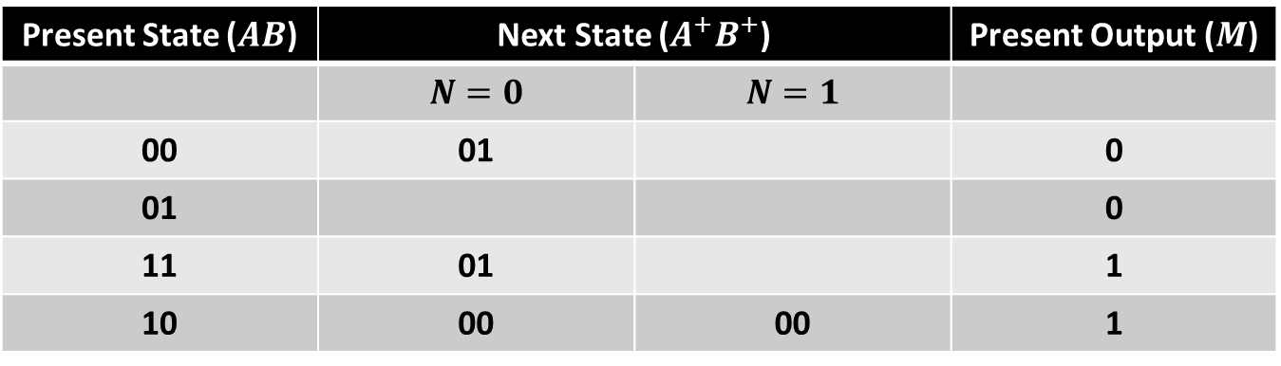
Transition Table
Present State ($AB$) | Next State ($A^{+}B^{+}$) |  | Present Output ($M$)
 | $$N=0$$ | $$N=1$$
00 | 01 |  | 0
01 |  |  | 0
11 | 01 |  | 1
10 | 00 | 00 | 1
State Table
Present State ($AB$) | Next State ($A^{+}B^{+}$) |  | Present Output ($M$)
 | $$N=0$$ | $$N=1$$
$$S_{0}$$ | $$S_{1}$$ | $$S_{3}$$ | 0
$$S_{1}$$ | $$S_{2}$$ | $$S_{2}$$ | 0
$$S_{2}$$ | $$S_{1}$$ | $$S_{3}$$ | 1
$$S_{3}$$ | $$S_{0}$$ | $$S_{0}$$ | 1

Slide 35
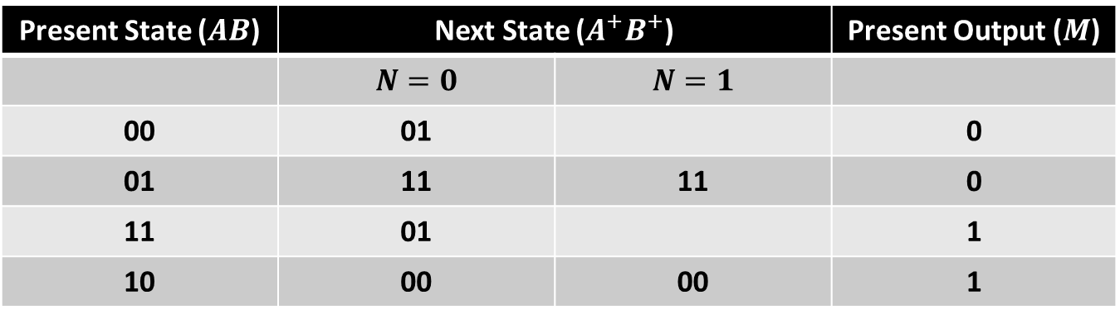
Transition Table
Present State ($AB$) | Next State ($A^{+}B^{+}$) |  | Present Output ($M$)
 | $$N=0$$ | $$N=1$$
00 | 01 |  | 0
01 | 11 | 11 | 0
11 | 01 |  | 1
10 | 00 | 00 | 1
State Table
Present State ($AB$) | Next State ($A^{+}B^{+}$) |  | Present Output ($M$)
 | $$N=0$$ | $$N=1$$
$$S_{0}$$ | $$S_{1}$$ | $$S_{3}$$ | 0
$$S_{1}$$ | $$S_{2}$$ | $$S_{2}$$ | 0
$$S_{2}$$ | $$S_{1}$$ | $$S_{3}$$ | 1
$$S_{3}$$ | $$S_{0}$$ | $$S_{0}$$ | 1

Slide 36

Transition Table
Present State ($AB$) | Next State ($A^{+}B^{+}$) |  | Present Output ($M$)
 | $$N=0$$ | $$N=1$$
00 | 01 | 10 | 0
01 | 11 | 11 | 0
11 | 01 | 10 | 1
10 | 00 | 00 | 1
State Table
Present State ($AB$) | Next State ($A^{+}B^{+}$) |  | Present Output ($M$)
 | $$N=0$$ | $$N=1$$
$$S_{0}$$ | $$S_{1}$$ | $$S_{3}$$ | 0
$$S_{1}$$ | $$S_{2}$$ | $$S_{2}$$ | 0
$$S_{2}$$ | $$S_{1}$$ | $$S_{3}$$ | 1
$$S_{3}$$ | $$S_{0}$$ | $$S_{0}$$ | 1

Slide 37
What questions do you have?

Slide 38
Next State and Output Equations
Serial Data Code Converter | Modern Digital System Design

Slide 39
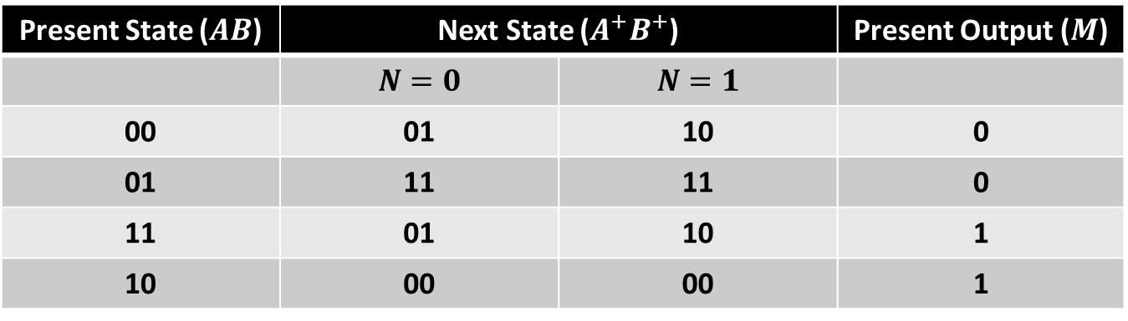
M
B’
B
A’
0
0
0
1
A
1
1
2
3
Present State ($AB$) | Next State ($A^{+}B^{+}$) |  | Present Output ($M$)
 | $$N=0$$ | $$N=1$$
00 | 01 | 10 | 0
01 | 11 | 11 | 0
11 | 01 | 10 | 1
10 | 00 | 00 | 1

Slide 40

M
B’
B
A’
0
0
0
1
$$M\left(A, B\right)=A$$
A
1
1
2
3
Present State ($AB$) | Next State ($A^{+}B^{+}$) |  | Present Output ($M$)
 | $$N=0$$ | $$N=1$$
00 | 01 | 10 | 0
01 | 11 | 11 | 0
11 | 01 | 10 | 1
10 | 00 | 00 | 1

Slide 41

$$A^{+}$$
AB
A’
A
N
N’
0
1
0
0
0
1
3
2
N
1
1
1
0
4
5
7
6
B’
B
B’
Present State ($AB$) | Next State ($A^{+}B^{+}$) |  | Present Output ($M$)
 | $$N=0$$ | $$N=1$$
00 | 01 | 10 | 0
01 | 11 | 11 | 0
11 | 01 | 10 | 1
10 | 00 | 00 | 1

Slide 42

$$A^{+}$$
AB
A’
A
N
N’
0
1
0
0
0
1
3
2
N
1
1
1
0
4
5
7
6
B’
B
B’
$$A^{+}\left(N, A, B\right)=NA^{′}+$$

Slide 43

$$A^{+}$$
AB
A’
A
N
N’
0
1
0
0
0
1
3
2
N
1
1
1
0
4
5
7
6
B’
B
B’
$$A^{+}\left(N, A, B\right)=NA^{′}+A^{′}B+$$

Slide 44

$$A^{+}$$
AB
A’
A
N
N’
0
1
0
0
0
1
3
2
N
1
1
1
0
4
5
7
6
B’
B
B’
$$A^{+}\left(N, A, B\right)=NA^{′}+A^{′}B+NB$$

Slide 45

$$B^{+}$$
AB
A’
A
N
N’
1
1
1
0
0
1
3
2
N
0
1
0
0
4
5
7
6
B’
B
B’
Present State ($AB$) | Next State ($A^{+}B^{+}$) |  | Present Output ($M$)
 | $$N=0$$ | $$N=1$$
00 | 01 | 10 | 0
01 | 11 | 11 | 0
11 | 01 | 10 | 1
10 | 00 | 00 | 1

Slide 46

$$B^{+}$$
AB
A’
A
N
N’
1
1
1
0
0
1
3
2
N
0
1
0
0
4
5
7
6
B’
B
B’
$$B^{+}\left(N, A, B\right)=N′A^{′}+$$

Slide 47

$$B^{+}$$
AB
A’
A
N
N’
1
1
1
0
0
1
3
2
N
0
1
0
0
4
5
7
6
B’
B
B’
$$B^{+}\left(N, A, B\right)=N^{′}A′+A^{′}B+$$

Slide 48
$$B^{+}$$
AB
A’
A
N
N’
1
1
1
0
0
1
3
2
N
0
1
0
0
4
5
7
6
B’
B
B’
$$B^{+}\left(N, A, B\right)=N^{′}A′+A^{′}B+N^{′}B$$

Slide 49

Next State and Output Equations
$$M\left(A, B\right)=A$$
$$A^{+}\left(N, A, B\right)=NA^{′}+A^{′}B+NB$$
$$B^{+}\left(N, A, B\right)=N^{′}A′+A^{′}B+N^{′}B$$

Slide 50
What questions do you have?

Slide 51
Verilog Implementation
Serial Data Code Converter | Modern Digital System Design

Slide 52

Verilog Implementation
We are now ready to implement our design in Verilog
Moore Design Pattern
$M\left(A, B\right)=A$
$A^{+}\left(N, A, B\right)=NA^{′}+A^{′}B+NB$
$B^{+}\left(N, A, B\right)=N^{′}A′+A^{′}B+N^{′}B$

Slide 53
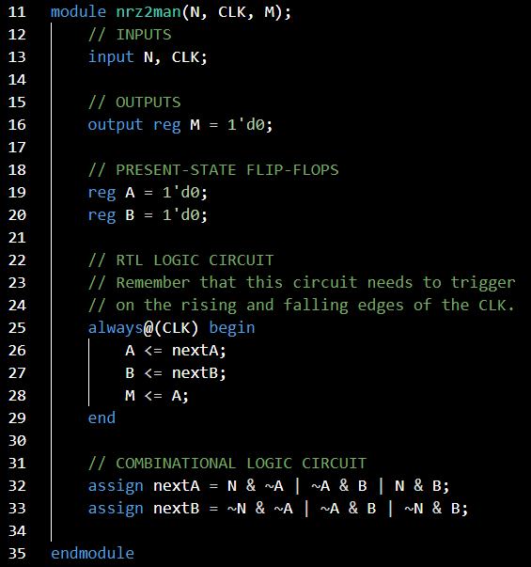

Slide 54
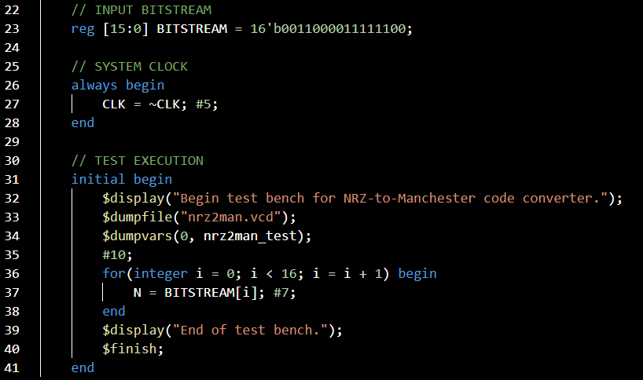

Slide 55
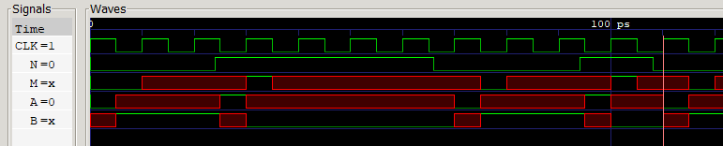
????

Slide 56
$$0$$
$$S_{0}$$
$$S_{1}$$
$$0$$
$$0$$
$$1$$
$$0,1$$
$$0$$
$$0,1$$
$$S_{3}$$
$$S_{2}$$
$$1$$
$$1$$
$$1$$
Notes:
Notice that there’s no real indication of which state to begin with.

Slide 57

$$Start$$
$$0$$
$$S_{0}$$
$$S_{1}$$
$$0$$
$$0$$
$$1$$
$$0,1$$
$$0$$
$$0,1$$
$$S_{3}$$
$$S_{2}$$
$$1$$
$$1$$
$$1$$
Notes:
Notice that there’s no real indication of which state to begin with.

Slide 58
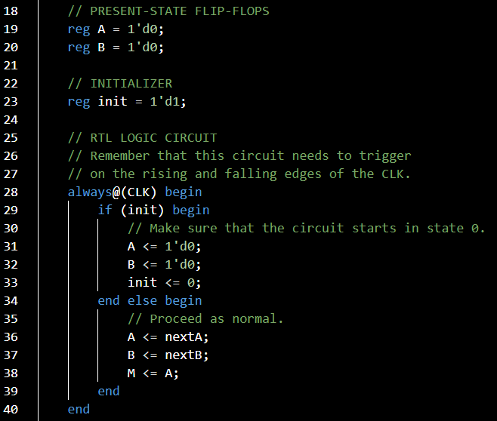

Slide 59
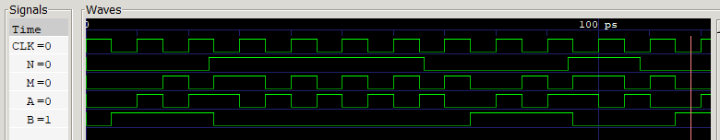

Slide 60
What questions do you have?

Slide 61
Lecture Recap
Design Specification
State Graph
State Table
Transition Table
Next-State and Output Equations
Verilog Implementation

Slide 62
Design Example: Serial Data Code Converter
ECE 2372 | Modern Digital System Design | Texas Tech University

